Slide 1

March Madness Basketball Tournament
General Setup:
About 350 College Teams play 26 (?) games over the course of 4 (?) Months („Season“)
Top 68 Teams advance to the final Tournament
Tournament Play-Ins: 8 Teams → 4 elimination matches on neutral court
64 remaining teams are going through 5 elimination rounds („Finals“) to determine the 2 finalists
There are additional matches played (invitational tournaments, typically the stronger teams) between „Season“ and „Finals“ that provide even more data
→ more impact- and meaningful data

Slide 2
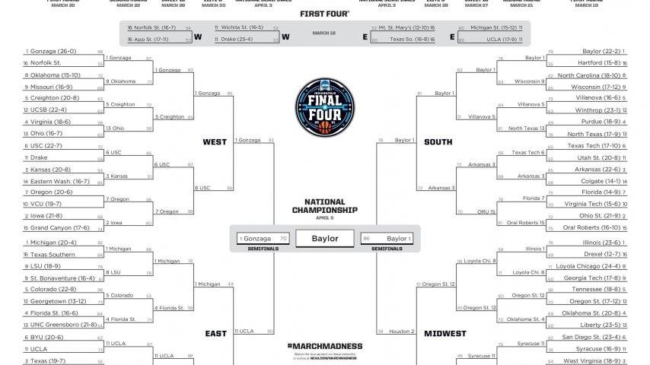
Seeding & Brackets:

Slide 3
Slide 1

Slide 4
Slide 2

Slide 5
Slide 3

Slide 6
Slide 4

Slide 7
How did it go / what did we find:
Turns out that College Basketball is not so easily predictable:
Roster of College teams change a lot year by year by nature
Teams play only against a small portion of all teams, so having (un)favorable match-ups skew the perceived strength during the „Season“
Conclusions:
The fact that we didn‘t find any obvious correlation doesn‘t mean there can‘t be some – actually there is groups that have been using models based on Machine Learning tools in the past, which predicted the results quite well (be it thanks to luck, or model quality)
Would be cool to look further into this, but currently outside our skill range

